Slide 1
Workbook Financing (Planning)
Internal Use Only
April 2017
EXCEL FILE:

Slide 2
Disclaimer
The content of this workbook has been produced by KPMG Germany/Deal Advisory on the basis of German accounting standards and/or IFRS, as well as considering KPMG Germany’s firm and country requirements, regulations, processes, policies and best practices. Please check your local accounting and other requirements before applying the content.

Slide 3
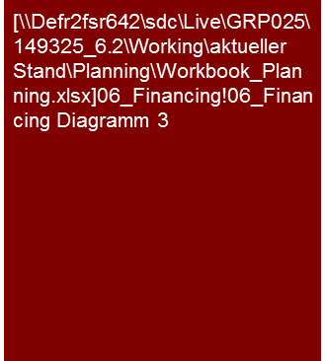

Overview (1/5) – Mission statement
Financing (Planning)
Flag: Tools listed are commonly used in Germany and may differ in other regions.
Mission Statement:
Transparency about the future capital structure, security of financing and market conformity of the financing for the proper consideration in transactions/valuations
Customer situation
Definition/Methodology/Tools of the basis analysis
Buy Side/Sell Side/JV
Transition from enterprise to equity value (VAL and M&A)
Consideration of the financial risk in the valuation (VAL)
Turnaround
Determination of future lack of coverage
Sufficient refinancing
Maintenance of covenants
Net debt
Covenants
Definition and Methodology
Definition (net debt, debt-like items, etc.) analogous past analysis (→ Workbook Financing - Net-debt)
Along with items from the balance sheet, off-balance sheet financing-like circumstances are to be considered (e.g. factoring), so as to appropriately reflect financing risks, especially in the framework of a valuation
Assure complete classification of balance sheet objects (bucket approach see also Working Capital)
Mentioning leverages, debt ratios, etc. always note, whether book or market values are stated.
Parameters:
(Net) Debt/EBITDA
(Net) Debt/EBIT
(Net) Debt/FCF
EBIT(DA)/Interest expense (interest coverage ratio)
Tools
Analysis Toolbox
Bucket approach tool
Degree of standardization
Analysis toolbox
Bucket approach
Determination and collection of the sector-specific KPIs (Benchmarking Project)

Slide 4
Overview (2/5) – Structure of the analysis and corresponding workbooks
Financing (Planning)
Challenge:
Linking the balance sheet analysis to cash flow (balance sheet movements) and P&L analysis (e.g. changes in provisions or inventory valuation → EBITDA adjustments).
Value/Price relevance of the balance sheet analysis
Profile of ”P&L" and "Cash Flow"
Enterprise value (e.g. EBIT x multiple)
Analysis tool - Bucket approach
Workbook "Financing"
Directly relevant to valuation: Analysis of the balance sheet (and off-balance sheet circumstances) for financial debt and debt-like items; Market value of pension and financial liabilities.
Additional analyses (evaluation of financial stability):
Headroom (free credit limits)
Amount of loans with due dates
Leverage
Other Balance Sheet Items
Net (financial) debt
Directly relevant to valuation: ”Sorting" of the other balance sheet items into debt-like items (e.g. differentiation of interest bearing and non interest bearing other liabilities) or working capital (e.g. provisions for outstanding invoices)
Additional analyses
Understanding of cash flow and/or result effects in connection with changes in other balance sheet items
”Completeness check" for net debt and WC analysis
+/-
Workbook “Working Capital"
+/-
+/- working capital adjustment
Directly relevant to valuation: Determination of the average funds committed (purchase agreement: extent and definition for target WC); Drivers for future binding of funds (working capital days for DCF valuation model)
Additional analyses (partially relevant for valuation/financing)
Seasonality (→ financing headroom required)
Special effects (dependent on business model, balancing policy, factoring & such) → if necessary consider in valuation
Balance sheet valuation issues and PPA subjects
other adjustments (e.g. Capex backlog)
Workbook “investments"
+/-
Directly relevant to valuation: Capex requirements and maintenance costs (in comparison to depreciation, as well as investment and maintenance backlog if necessary)
Additional analyses (understanding of business model):
Capacity and utilization, state of technology
Change of location/”Manufacturing footprint"
Market value (PPA) and impairment needs
=
Equity value/ Purchase price

Slide 5
Overview (3/5) – Flow diagram
Financing (Planning)
Results of analysis
Core statement/Conclusive valuation
Headroom
Past analysis
Covenants
Peer group capital structure
Planning analysis
Financing
Fair market interest
Refinancing & repayment
Optimization of capital structure
Market value vs. book value
Scope of the workbooks

Slide 6
Overview (4/5) – Pitfalls
Financing (Planning)
No. | Pitfalls/Lessons learned
 | Availability of liabilities: Are liabilities even available in the amount shown in the planning or as taken up (e.g. benchmarking of liabilities KPIs with sector parameters)? Special importance in case of restructuring, reproduction of liabilities in accordance with current contractual obligations (prior to/after restructuring loan)
 | Comparability: With the analysis of the past and planning as well as the benchmarking of the planning in the market and competitive environment/peer group, the general comparability of the parameters analyzed is to be assured, if necessary by means of adjustments/conversions. Differences may result, for instance, with: The delineation: Differences in financial reporting standards or utilization of accounting options (e.g. presentation as expenses vs. capitalization and depreciation) The fundamental design and arrangement of economically identical/similar issues: Various measures for achieving the same economic result (e.g. acquisition vs. leasing/rental, borrowing vs. factoring) A lack of complete comparability (e.g. lack of information about the impact of options, etc. with peers that appear to be essential) is to be mentioned and appropriately recognized (e.g. “only limited validity“).
 | Missing assumptions for future financing/capital structure: Frequently there is no planning for the utilization of excess cash or a distribution plan, but rather the annual profit is simply retained. The planning is then adjusted correspondingly, i.e. assumption of pay-outs (e.g. on the basis of peer group pay-out ratios), repayment of liabilities, development of a normal market debt (peer group) etc. Attention should be paid to impact on covenants.
 | Consistency of interest assumptions: Frequently the interest rates/implicit assumptions deviate from the development of the reference interest and spread in the planning of interest assumptions to other positions (e.g. cost of capital – risk free rate and market risk premiums)
 | Transition actual to plan: Frequently, the first planning year/budget is not based on audited results from the previous actual year, but rather on a forecast/extrapolation for the previous actual year. Frequently, the audited results and forecast/extrapolation for the previous actual year deviate from one another. Breaches may then occur between the previous actual year and first planning year/budget that may have to be adjusted in case of materiality (adjustment of planning, P&L and balance sheet).
1
2
3
4
5

Slide 7




Overview (5/5) – Core issues
Financing (Planning)
Core Issue | Specific analysis | Page(s)
How is the net debt composed and how does it develop over time? | Apply past analysis and net debt definition there (especially with respect to debt-like items, off-balance sheet financing)! If necessary harmonization or transition to definition according to client, SPA (e.g. with DD or info memo), etc. Analysis of composition and amount of debt ratio over time | 8
2. What causes changes in net debt over time and what assumptions have been made for (re)financing/repayment? | Analysis of financial deficit/surplus (operative cash flow, investments, working capital, dividends, repayment due on liabilities, etc.) on the basis of the planning analysis Apply past analysis with regard to due dates (level of loans) Assumptions for refinancing (interest rate, instruments,...). Is there even any chance of refinancing (especially in cases of restructuring frequently difficult)? Measures for the elimination of possible lack of coverage | 9
Is there sufficient financing headroom? | Analysis of essential parameters and covenants (e.g. debt coverage ratio, interest coverage ratio) and their threshold values (contractual as well as what is common for sector) over time Analysis of financing peaks (in the course of the year), fluctuations in cash flow Consider necessity of operative cash on hand (minimum liquidity)? How high is the "headroom" (free credit limits) or room for additional uptake of credit/lines of credit in planning period? Impact of transaction (e.g. CoC, repayment of shareholder loans, acquisition financing, etc.) - see past analysis | 10
Do special aspects of the financing have to be considered in a valuation? e.g.: Major differences between market value and book value of the liabilities Is the planned financing consistent with market expectations? Can the financing structure be optimized? | Market value/Book value Inclusion of the knowledge from the past analysis in the planning Analysis of differences of provisions and defined benefit obligations in pensions Check that interest rate of debt approximates market interest rate Customary market financing Compare debt ratios and, if necessary, parameters to analysts’ expectations, KPIs of peer group companies (benchmarking) – Note: pay attention to uniform definition, instruments (e.g. leasing vs. purchase) and if necessary, accounting! Identify & analyze explanation for possible discrepancy to market expectation (e.g. balancing, leasing, scale effects,…) If necessary adjust to market level depending on purpose of valuation Optimized financing structure Are more favorable financing conditions or forms of financing available? (→ Debt Advisory) | 11-12
360° CQ

Slide 8

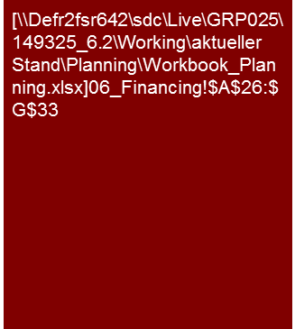

1. How is the net debt composed and how does it develop over time?
Financing (Planning)
The current financing structure of XXX AG with primarily senior and mezzanine debt is to be continued in the planning period.
The increase of net debt is relatively analogous to the increase in company values so that the debt ratio remains relatively constant (at market values)
We consider the planning for financing to be XXX.
Net debt
The XXX AG debt consists of ca. 40% senior debt and ca. 40% mezzanines, plus ca. 20% operational loans. This ratio is expected to remain unchanged for the most part during the planning period.
The net debt should climb by about a quarter in the analysis period from €65 mil. to €82 mil. This should primarily result from an expansion of the senior debt and the mezzanine.
[... Details on senior debt, mezzanine and operating loan (terms, conditions, banks) ...]
[... If applicable, details on developments during the year, peaks, etc. ...]
In the framework of the planning dividends of x% of the annual profit were considered and observed in determining the capital structure.
The debt ratio at market values remains, for the most part, at a constant level during the period of analysis, despite an increase in the net debt.
[.... Details on the necessary minimum cash on hand, if applicable ....]
Actual
Plan
Alternative
Presentation of debt ratio at market values, i.e. market value of debt (approximately also book value of debt acceptable) and market value of equity (market cap, company value) depends on information available. Generally the presentation at market values is preferable.
If presentation of debt ratio at book values, note and explain briefly
Tools
Excel analysis

Slide 9
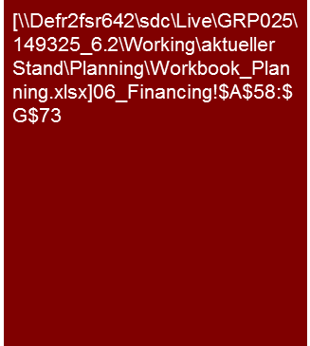
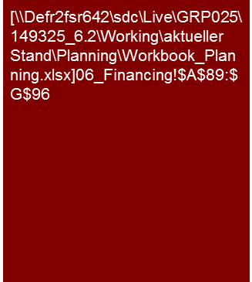
2. What causes changes in net debt over time and what assumptions have been made for (re)financing/repayment?
Financing (Planning)
The XXX AG uses its operating profits and the funds released by the optimization of the working capital primarily for dividends to shareholders/ repayment of debt/creation of cash and cash equivalents…
xxx
Tools
Excel analysis

Slide 10

3. Is there sufficient financing headroom?
Financing (Planning)
The XXX AG has, with regard to the maintenance of the agreed covenants and the available lines of credit, sufficient financing headroom.
Covenants
The credit agreements of the XXX AG are primarily based on the following covenants and limits:
XXX (= X/Y) 2.1x
XXX (=X/Y) 1.5x
The XXX AG maintains the agreed limits in the period of analysis. With full utilization of the limits there would be a financing headroom of €x million until the end of the planning horizon.
The capital needs of the XXX AG increase in the planning period from €X million to €Y million. The additional need can be covered by the agreed upon line of credit with the XXX.
There is an unused line of credit of ca. €x.x million till the end of the planning period.
If necessary, discuss the developments and peaks in the course of the year.
Actual
Plan
Capital needs and line of credit
Alternative presentation including cash and cash equivalents (liabilities and line of credit then reduced)
Pay attention to definitions of the covenants in accordance with the client credit agreements, generally (Net) debt to FCF or EBIT(DA)
Tools
Excel analysis

Slide 11

4. Do special aspects of the financing have to be considered in a valuation? (1/2)
Financing (Planning)
In the valuation/determination of the purchase price/…, the difference between the market value and the book value of debt is €x million.
This leads to an increasing/decreasing company value/purchase price.
Debt (book value vs. market value)
The last comprehensive refinancing of the XXX AG was in 20YY. This was done at an average interest rate of X% p.a. As a result of the market conditions, XXX AG could refinance today at more favorable conditions in the area of X %.
There is therefore currently a difference between the market and book value of debt of ca. €x.x million that successively decreases over the residual term of the loan.
We have taken this into consideration in the framework of the valuation/determination of the purchase price/…. To that end, XXX
Actual
Plan
Tools
Excel analysis

Slide 12
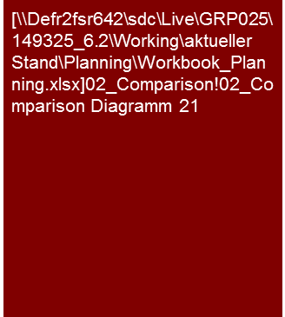
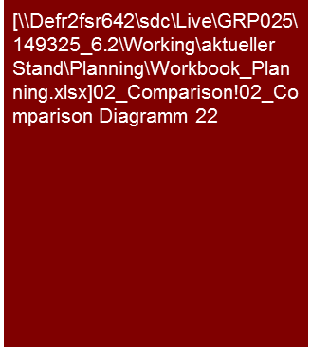
4. Do special aspects of the financing have to be considered in a valuation? (2/2)
Financing (Planning)
The debt ratio (market value) of the XXX AG ranges within the analysts’ expectations and the ratios of comparable companies in the planning period.
In view of this we consider the planned capital structure of the XXX AG to be plausible and have based our valuation on this.
Debt ratio (market value) in comparison to analysts' expectations
XXX
Debt ratio (market value) in comparison to peer group
Explain composition in footnote (e.g. including pensions,…)
If possible a presentation to the market values should be made, i.e. at market value of debt (as an approximation the book value of debt is generally acceptable) and market value equity (market cap).
Note if presentation at book value and briefly explain
Alternatively present for covenant ratios as well, if reasonable
Tools
Excel analysis

Slide 13
© 2017 KPMG International Cooperative (“KPMG International”). KPMG International provides no client services and is a Swiss entity with which the independent member firms of the KPMG network are affiliated.

